Slide 1
WELCOME
Presentation by
- A . Hemapriya
-S . Jeffry shiny
-M. Abirami
-A . Sujitha

Slide 2
ABOUT TIC –TAC- TOE GAME.
Tic-tac-toe is a game in which two players take turns in drawing either an ` O' or an ` X' in one square of a grid consisting of nine squares.
The winner is the first player to get three of the same symbols in a row.

Slide 3
IMPORTANCE OF TIC TAC TOE
The game of tic-tac-toe is a game of predictability.
The moves that are believed to be important are highly predictable.
This also makes it a game of opposites in a way, because this goes against the definition of an “important move”.
But this predictability is what helps foster strategic thinking in children.

Slide 4
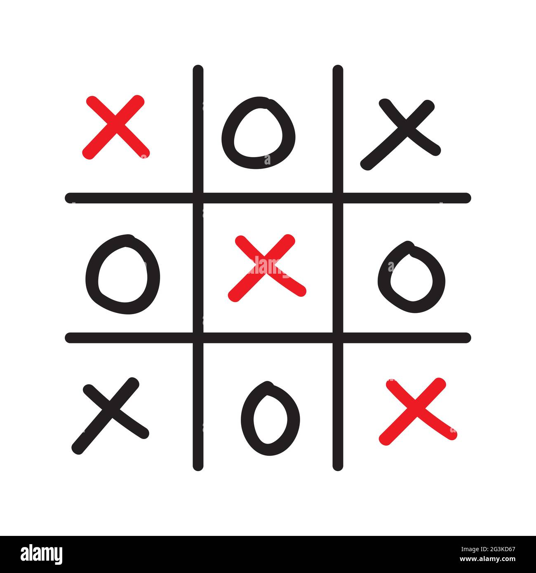
HISTORY OF TIC TAC TOE GAME.
Games played on three-in-a-row boards can be traced back to ancient Egypt, where such game boards have been found on roofing tiles dating from around 1300 BC. An early variation of tic-tac-toe was played in the Roman Empire, around the first century BC.

Slide 5
TIC TAC TOE GAME TYPE
Tic tic tac toe, also called noughts and crosses, is a two-player pencil-and-paper game.
Although strategy can be used, it isn't necessary for young children to have fun.
The goal of the game is to get three X's or O's in a row before your opponent does.

Slide 6
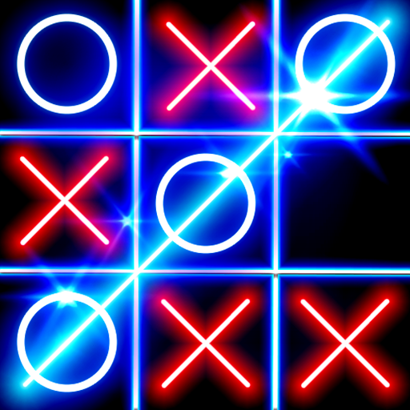
TIC TAC TOE GAME

Slide 7
CONCLUSION FOR TIC TAC TOE
a game in which two players alternately put Xs and Os in compartments of a figure formed by two vertical lines crossing two horizontal lines and each tries to get a row of three Xs or three Os before the opponent does.

Slide 8
THANK YOU!

